Slide 1

“RAILWAY SCHEDULING"
GROUP NO:
Roll No. | Name of Students
288 | Pratik Rawal
296 | Gaurav Samant
297 | Yash Sanghavi
310 | Adesh Shah
<number>

Slide 2
INTRODUCTION
In our day to day life we frequently travel with trains maybe for a short or long travel .
For the convenience of travellers we require a schedule to display the time of arrival ,time of departure,stations halts,etc.With the help of programming services we have been able to successfully communicate to the passengers via schedule in a easy and faster way.
Scheduling via programming has been both convinient to the user as well as the railway authorities.Thus programming​ have helped us to manage this cluster of railways.
<number>

Slide 3
ALGORITHM
<number>

Slide 4
FLOWCHART
<number>

Slide 5
MODULES
LISTING OF MODULES
Our program is divided into 5 prominent modules. Each module signifies a train. The modules are further divided into 3 sections
1)Search by Station. 2)Search by Time. 3)Full schedule.
Each section is further divided into different blocks depending upon the data entered by the user. The conditions are checked for equality until a match occurs. After which the corresponding code block is executed. After each subsequent choice in the module is complete, the user is given a choice – Whether or not he/she wishes to restart the search or abort the program.
Depending on the choice entered the entire program will be re-executed or the program will end
<number>

Slide 6
EXPLANATION OF EACH MODULE
MODULE 1. Ahmedabad Express
Under Ahmedabad option the user is introduced to three choices. He can get acquainted about the position of the Ahmedabad Express at a specific time or when the Ahmedabad Express will reach a particular station.
If he chooses the “ENTER STATION” option, he has to enter the name of the station at which he wants to know the arrival time of the Ahmedabad Express. If the station entered by the user isn’t on the route of the Ahmedabad Express, then a message will be displayed saying that the Ahmedabad Express doesn’t halt at the station.
If he chooses the “ENTER TIME” option, he will be required to enter the time at which he wants the position of the Ahmedabad Express. The time entered by the user is cross referenced against a series of time ranges and the corresponding status is displayed. If the user wishes to know the entire schedule of the Ahmedabad Express he should choose the third option, the full scheduled is shown displaying the estimated arrival time, departure, halt, and the distance covered by the Ahmedabad Express at a particular station.
<number>

Slide 7
MODULE 2
Pune Express
Under Pune option the user is introduced to three choices. He can get acquainted about the position of the Pune Express at a specific time or when the Pune Express will reach a particular station.
If he chooses the “ENTER STATION” option, he has to enter the name of the station at which he wants to know the arrival time of the Pune Express. If the station entered by the user isn’t on the route of the Pune Express, then a message will be displayed saying that the Pune Express doesn’t halt at the station.
If he chooses the “ENTER TIME” option, he will be required to enter the time at which he wants the position of the Pune Express. The time entered by the user is cross referenced against a series of time ranges and the corresponding status is displayed.
If the user wishes to know the entire schedule of the Pune Express he should choose the third option, the full scheduled is shown displaying the estimated arrival time, departure, halt, and the distance covered by the Pune Express at a particular station.

Slide 8
MODULE 3
Nashik Express
Under Nashik option the user is introduced to three choices. He can get acquainted about the position of the Nashik Express at a specific time or when the Nashik Express will reach a particular station.
If he chooses the “ENTER STATION” option, he has to enter the name of the station at which he wants to know the arrival time of the Nashik Express. If the station entered by the user isn’t on the route of the Nashik Express, then a message will be displayed saying that the Nashik Express doesn’t halt at the station.
If he chooses the “ENTER TIME” option, he will be required to enter the time at which he wants the position of the Nashik Express. The time entered by the user is cross referenced against a series of time ranges and the corresponding status is displayed.
If the user wishes to know the entire schedule of the Nashik Express he should choose the third option, the full scheduled is shown displaying the estimated arrival time, departure, halt, and the distance covered by the Nashik Express at a particular station.

Slide 9
MODULE 4
Ratnagiri Express
Under Ratnagiri option the user is introduced to three choices. He can get acquainted about the position of the Ratnagiri Express at a specific time or when the Ratnagiri Express will reach a particular station.
If he chooses the “ENTER STATION” option, he has to enter the name of the station at which he wants to know the arrival time of the Ratnagiri Express. If the station entered by the user isn’t on the route of the Ratnagiri Express, then a message will be displayed saying that the Ratnagiri Express doesn’t halt at the station.
If he chooses the “ENTER TIME” option, he will be required to enter the time at which he wants the position of the Ratnagiri Express. The time entered by the user is cross referenced against a series of time ranges and the corresponding status is displayed.
If the user wishes to know the entire schedule of the Ratnagiri Express he should choose the third option, the full scheduled is shown displaying the estimated arrival time, departure, halt, and the distance covered by the Ratnagiri Express at a particular st

Slide 10
MODULE 5
Jaipur Superfast Express
Under Jaipur Superfast option the user is introduced to three choices. He can get acquainted about the position of the Jaipur Superfast Express at a specific time or when the Jaipur Superfast Express will reach a particular station.
If he chooses the “ENTER STATION” option, he has to enter the name of the station at which he wants to know the arrival time of the Jaipur Superfast Express. If the station entered by the user isn’t on the route of the Jaipur Superfast Express, then a message will be displayed saying that the Jaipur Superfast Express doesn’t halt at the station.
If he chooses the “ENTER TIME” option, he will be required to enter the time at which he wants the position of the Jaipur Superfast Express. The time entered by the user is cross referenced against a series of time ranges and the corresponding status is displayed.
If the user wishes to know the entire schedule of the Jaipur Superfast Express he should choose the third option, the full scheduled is shown displaying the estimated arrival time, departure, halt, and the distance covered by the Jaipur Superfast Express at a particular station.

Slide 11
‘C’ CONCEPTS USED
This program uses a cluster of functions to make it effectively convenient and efficient .
Some of the concepts used :
SWITCH -- It has been used to provide a choice to the user to select the respective train of his/her choice.
NESTED SWITCH-- Used to provide more options like to view the time of arrival of the train by entering time or just display the entire schedule or to locate the train location.
Other concepts used to build this program are IF ,IF- ELSE ,WHILE STATEMENTS. Various logical operators are too used.
<number>

Slide 12
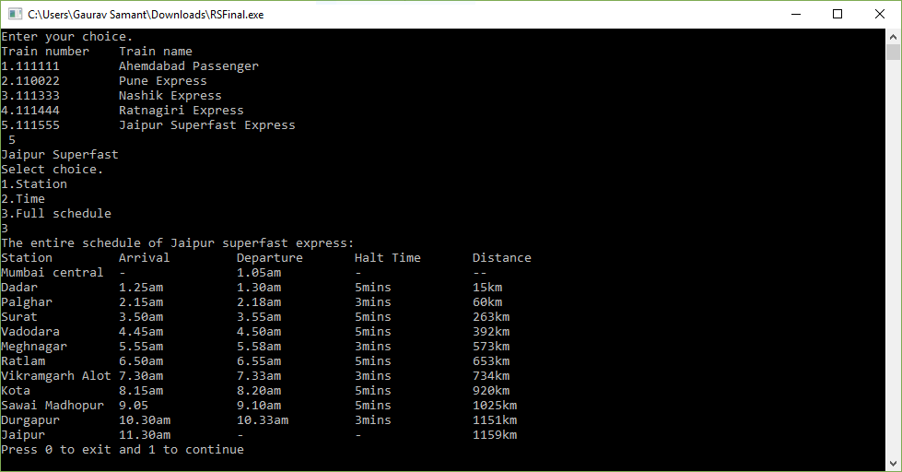
SCREEN SHOTS
<number>

Slide 13
CONCLUSION
Thus this program is basically designed to show the user the required schedule of a train .
It displays time of arrival,time of departure ,the distance travelled . It also displays the halting time of the concerned train.
It requests the user to input his/ her choice of the train .
The program is user interactive by providing the user various options regarding his/her choice of the train like:
1) Stations between the route.
2)Time ---to locate the location of train.
3)Full schedule.
<number>

Slide 14
REFERENCES
<number>

Slide 15

<number>

